Slide 1
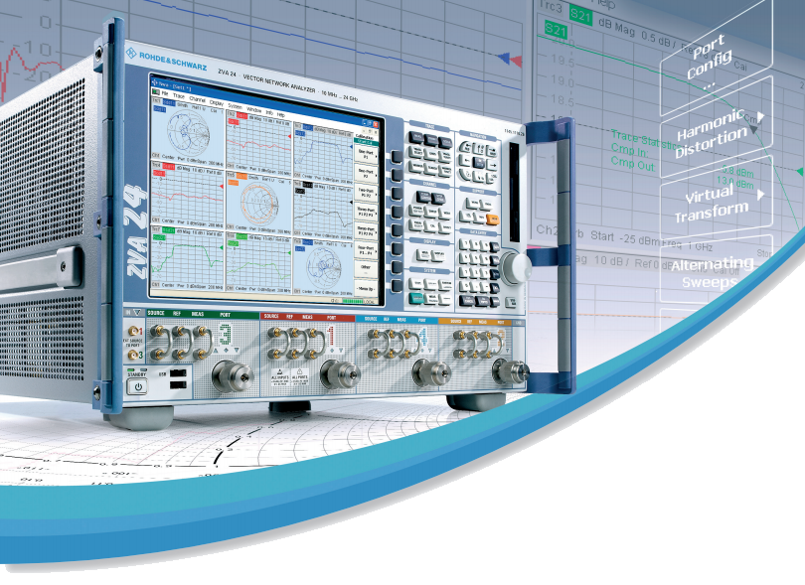
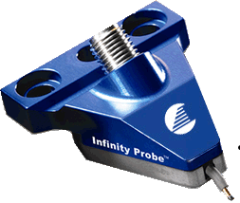
Extraction of Probe s2p Parameters

Slide 2
Agenda
Overview
Four steps to create an s2p file of the fixture or wafer probe
Exercise to validate the procedure
How to view the s2p file of the fixture or wafer probe
Deembedding the s2p file during power calibration
Summary

Slide 3
{ Overview }

Slide 4
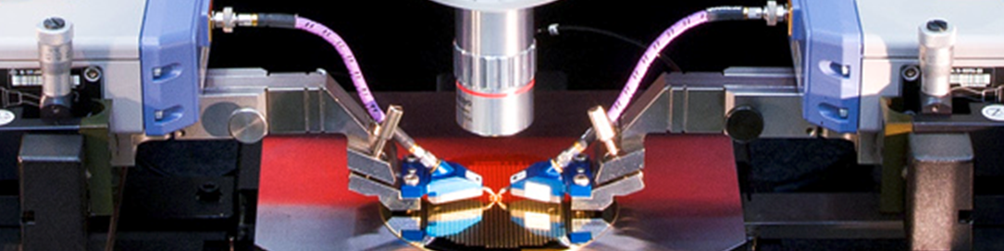

Port 1 “outer” error model
Port 2 “outer” error model
Port 1 “inner” error model
Port 2 “inner” error model
Do a two port coaxial calibration at the probe connectors.
This gives us the port 1 and port 2 “outer” error models.
Do a two port TRL calibration with the probe tips on the calibration substrate.
This gives us the port 1 and port 2 “inner” error models.
Use math to calculate the difference in the two error models.
This difference is captured in an s2p file at each calibrated port.
Port 1 probe s2p = P1 inner error model – P1 outer error model
Port 2 probe s2p = P2 inner error model – P2 outer error model

Slide 5
{ Four Steps }

Slide 6
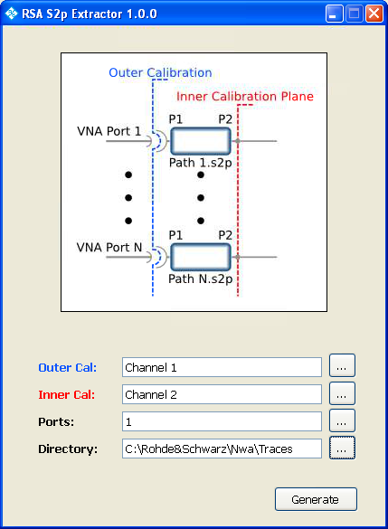








RSA s2p Extractor:
Launch the utility by pressing:
1. Select the channel that contains the “outer” cal.
Or select a saved cal file from the calibration pool
Select the channel that contains the ‘inner’ cal.
3. Select ports for s2p extraction.
4. Press Generate s2p Files.
An s2p file for each port will be saved in the Traces directory by default. This is the same directory that is used (by default) in the Deembedding routine.
Deembedding:
Launch Deembedding routine by pressing:

Slide 7
{ Verification }

Slide 8
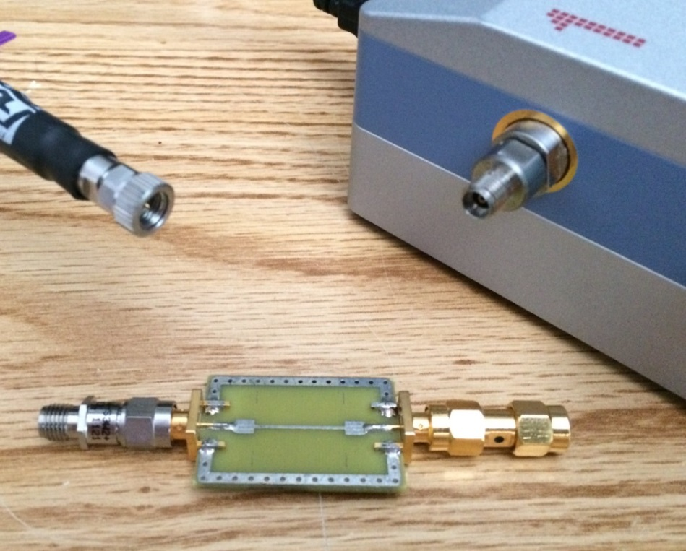

Exercise to Validate the Procedure
Scenario:
You have a male test cable.
You have a female auto cal unit.
The connection to your DUT passes through a 3 dB attenuator, a 100 ohm transmission line, and a male to male adaptor.
(This is the “test fixture.”)
Your Task:
Use the RSA s2p Extractor to find the s parameters of the test fixture.
Deembed the test fixture and demonstrate correct performance.

Slide 9
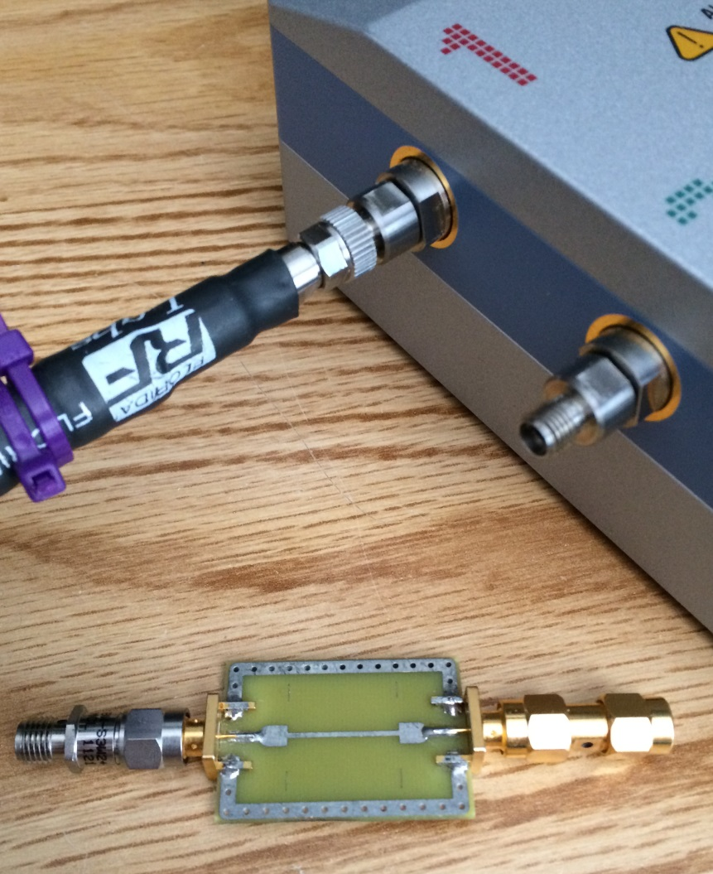

Step 1: Calibrate Channel 1 w/out the Fixture
This is the “outer” calibration plane because it is farther away from the DUT.
Fixture
(3 dB atten, 100 ohm line, SMA barrel)
VNA
Ch 1 “outer”
Cal plane
DUT
(50 ohm load)

Slide 10
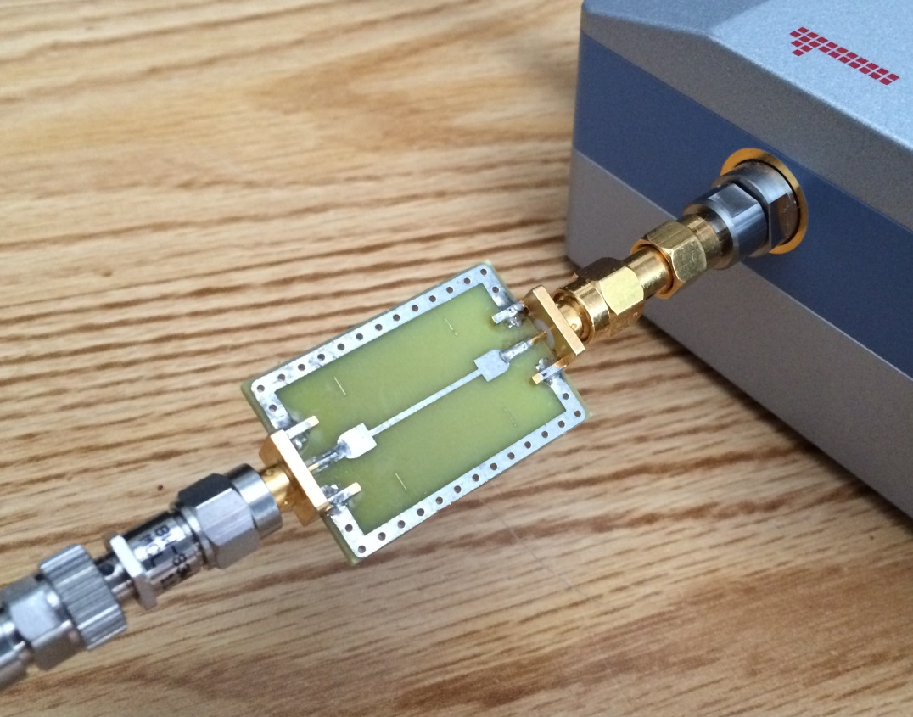
Step 2: Calibrate Channel 2 with the Fixture
Fixture
(3 dB atten, 100 ohm line, SMA barrel)
DUT
(50 ohm load)
VNA
Ch 2 “inner” Cal plane
This is the “inner” calibration plane because it is closer to the DUT.
Use the same channel settings in both channels.
Same IF BW
Same sweep range
Same number of points
…

Slide 11
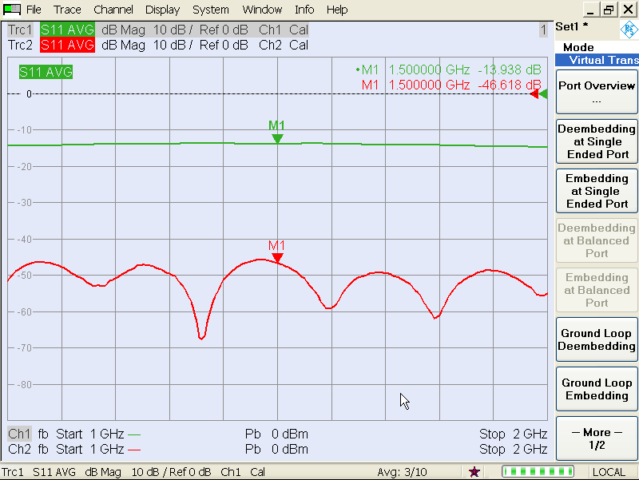

Measure the DUT with these two channels…
Channel 1 measures the Fixture plus DUT…
This is NOT what we want…
Channel 2 directly measures the DUT.
This is the correct result.
Fixture
(3 dB atten, 100 ohm line, SMA barrel)
DUT
(50 ohm load)
Ch 1 “outer”
Cal plane
Ch 2 “inner” Cal plane

Slide 12
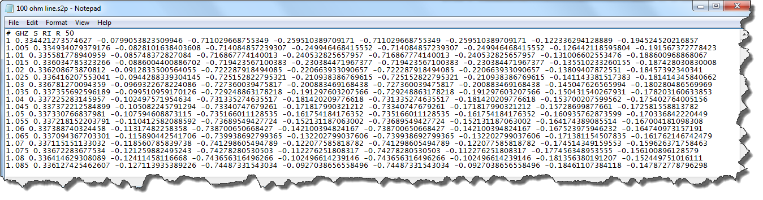
Step 3: Run the RSA s2p Extractor utility…

Slide 13
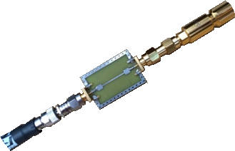
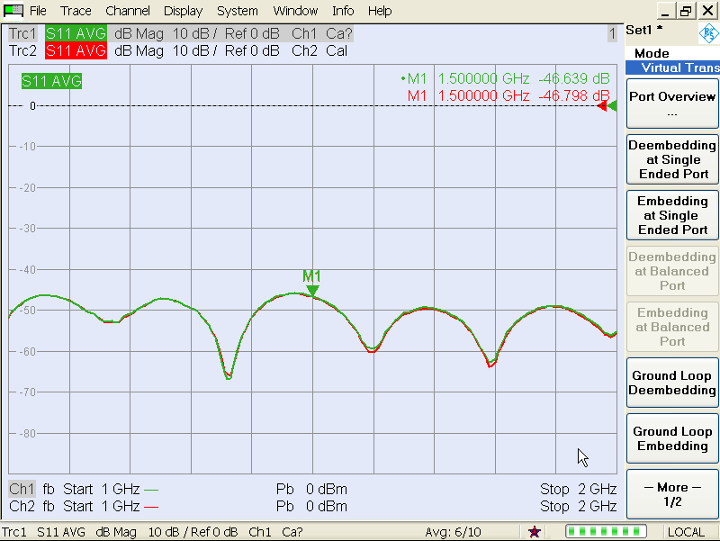
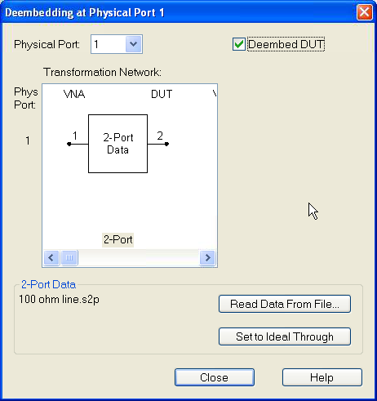

Step 4: Deembed the Fixture s2p file from Ch 1
Fixture
(3 dB atten, 100 ohm line, SMA barrel)
Channel 1, Port 1

Slide 14
Results after Deembedding:
This process shifts the calibration plane toward the DUT.
Ch 1 results now match Ch 2
Fixture
(3 dB atten, 100 ohm line, SMA barrel)
DUT
(50 ohm load)
Deembed
Ch 1 Cal
plane
Ch 2 Cal
plane

Slide 15
{ View s2p File of Fixture or Probe }

Slide 16
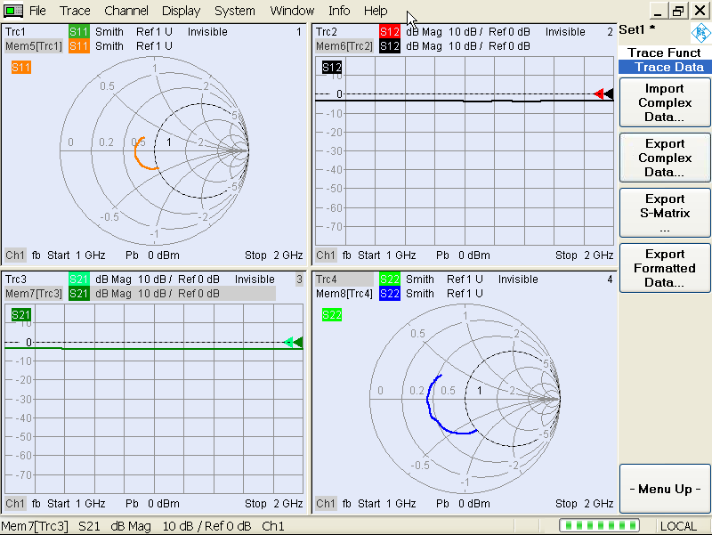
Want to view the s2p file of the Fixture?
Preset the ZVA
Set the start and stop frequency to match your s2p file
(optional on a 4 port ZVA) Press Port Mode -> Port Config and uncheck ports 3 and 4
Press Measure -> More -> More -> All S parameters (you get 4 display windows)
Select Trace 1, then press Trace Function -> Show Data (to uncheck it…)
Press Trace Function -> More -> Trace Data -> Import Complex Data
Select the file, and select S11 for trace 1.
Repeat for Trace 2 displaying S12.
Repeat for Trace 3 (S21) and Trace 4 (S22).

Slide 17
Want to view the s2p file of the Fixture?
Fixture
(3 dB atten, 100 ohm line, SMA barrel)

Slide 18
{ Deembedding during Power Cal}

Slide 19
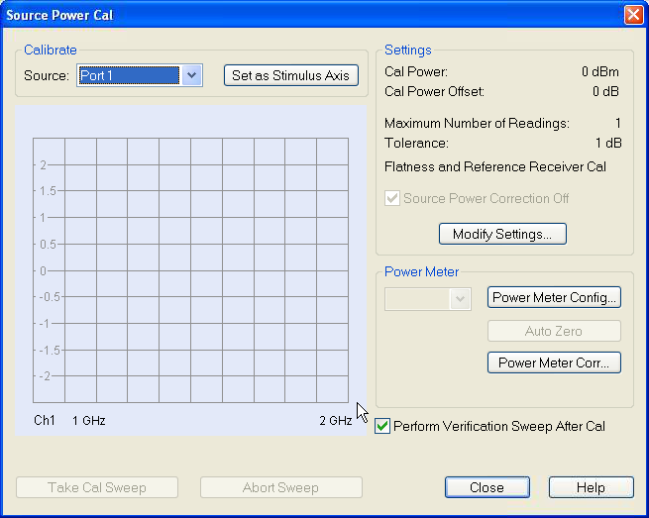
Want to Deembed during Power Calibration? (…)
Configure the channel for the measurement
Frequency sweep range, IF BW, power level, etc.
or Power sweep range, start and stop power, number of steps etc.
Press Cal -> Start Power Cal -> Source Power Cal
In the dialog box, select Power Meter Correction

Slide 20
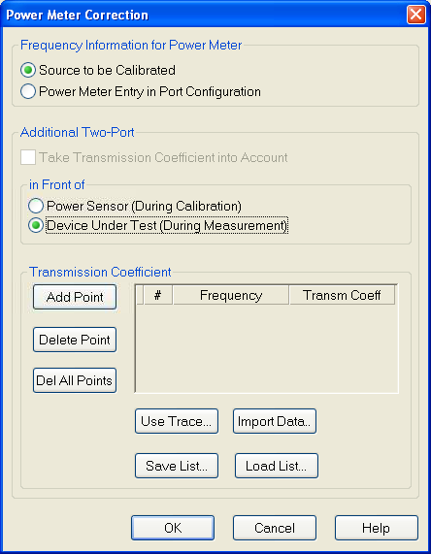


Want to Deembed during Power Calibration? (…)
In this dialog box we are going to Deembed the test fixture during measurement of the DUT, so we select (Additional Two-Port in Front of)
Device Under Test (During Measurement)
Then we need to import the fixture data.
Press Import Data

Slide 21
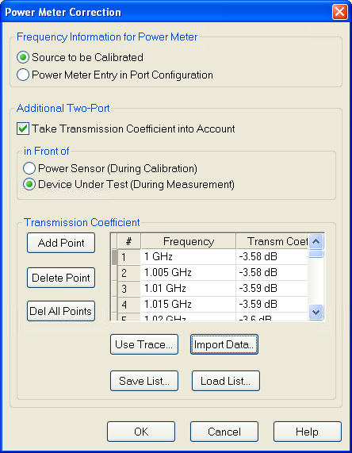
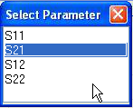
Want to Deembed during Power Calibration? (…)
Select the s2p file that corresponds to the test fixture.
Select S21, which represents the loss of the test fixture.
Activate with the Take Transmission Coefficient into Account checkbox.
Proceed from here with a normal power calibration at the connector plane.

Slide 22
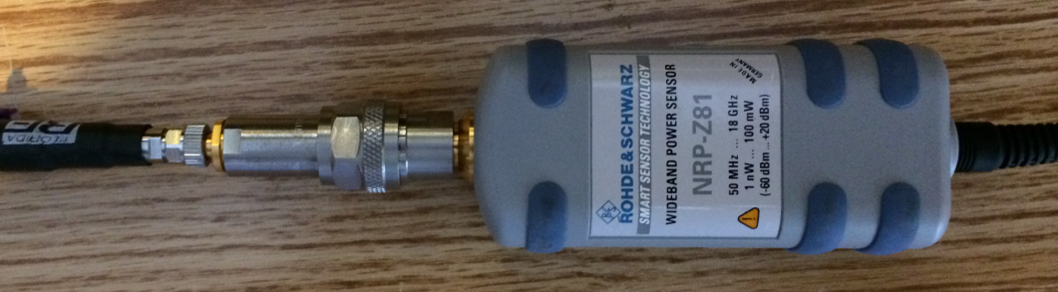
Deembed the Fixture during Power Calibration.
Summary for Power Calibration:
Power is calibrated here during
the Power calibration step
Fixture
(3 dB atten, 100 ohm line, SMA barrel)
But Deembedding the fixture means power is set and controlled at the DUT input during measurements.
Deembed

Slide 23
{ Conclusion }

Slide 24
Conclusion
The approach was confirmed using a connectorized “fixture.”
The fixture included a 100 ohm transmission line to create mismatch.
The fixture included a 3 dB attenuator on one end to force S11 and S22 to be very different from each other.
This approach can be used to deembed wafer probes.
Use TOSM or UOSM calibration at the outer cal plane.
Use TRL calibration on wafer, at the probe tips.
Generate s2p files for each probe.
Deembedding probes can simplify calibration.
Use s2p files to deembed probes during power calibration.
Did you notice that the 2 port fixture’s s2p parameters were measured
using one port of the VNA? Could be a handy trick at some point…

Slide 25


Slide 26
{ End }

